Slide 1


Oğulcan AKCA
September 19, 2023

Slide 2



TABLE OF CONTENTS
Executive Summary
Introduction
Methodology
Results
Conclusion
Appendix

Slide 3
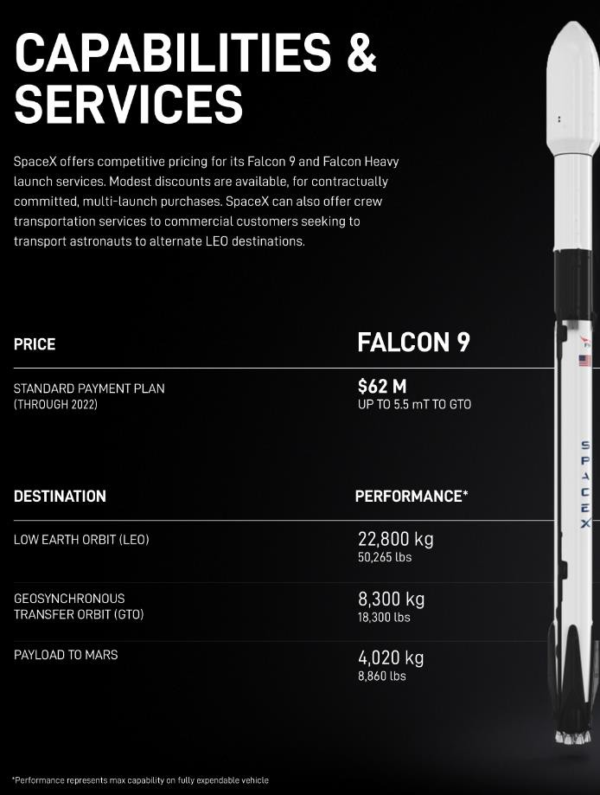
EXECUTIVE SUMMARY
SpaceY, a newcomer in the commercial rocket launch industry, is gearing up to compete with SpaceX. SpaceX offers launch services with a starting price of $62 million, which includes the provision to reserve some fuel for the first stage rocket booster's landing, enabling it to be reused.
According to SpaceX's public statements, the cost of building a first stage Falcon 9 booster is estimated to be over $15 million, not factoring in R&D cost recovery or profit margins.
The models developed in this report have shown an 83.3% accuracy in predicting the successful landing of the first stage rocket booster based on mission parameters such as payload mass and the desired orbit.
This accuracy allows SpaceY to enhance its competitive bidding strategy against SpaceX by using the predicted first stage landing success as an indicator of launch cost.

Slide 4

INTRODUCTION: BACKGROUND
This report has been prepared as part of the IBM Data Science Professional Certification
In this final project, I assume the position of a data scientist at SpaceY, a recently established rocket company. Leveraging the insights and models presented in this report, SpaceY can now enhance its competitive advantage by making more knowledgeable and strategic bids when competing with SpaceX for rocket launch contracts.

Slide 5
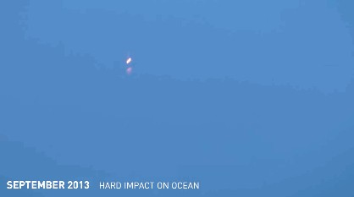
INTRODUCTION: BUSINESS PROBLEM
SpaceX promotes Falcon 9 rocket launches at a price point of $62 million, provided that the first stage of their rockets can be reclaimed and reused.
It's important to note that the estimated cost of manufacturing the first stage alone is projected to be over $15 million, excluding considerations for recouping research and development expenses or adding profit margins to the equation
In light of these factors, the primary objective of this report is to develop an accurate predictive model that can gauge the likelihood of a successful first stage rocket landing.

Slide 6

6

Slide 7
METHODOLOGY
For this report the data science methodology used can be outlined as such:
Data collection
Data wrangling
Exploratory data analysis
Data visualization
Model development
Reporting results to stakeholders

Slide 8
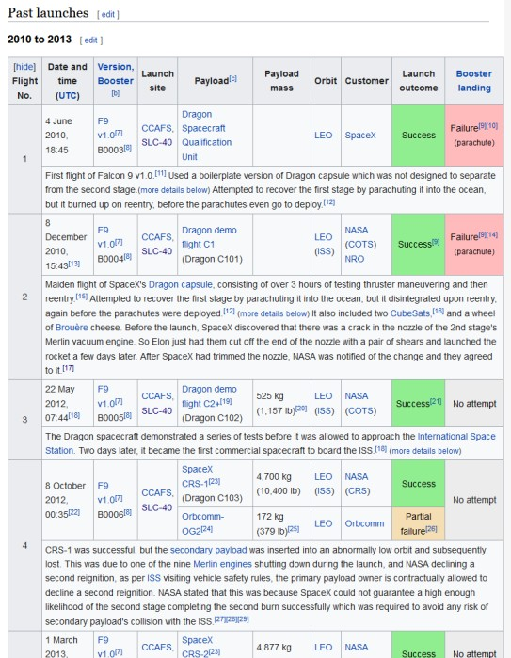
METHODOLOGY
Data Collection
API
Acquired historical launch data from Open Source REST API for SpaceX
Requested and parsed the SpaceX launch data using the GET request
Filtered the dataframe to only include Falcon 9 launches
Replaced missing payload mass values from classified missions with mean
Web Scraping
Acquired historical launch data from Wikipedia page 'List of Falcon 9 and Falcon Heavy Launches'
Requested the Falcon9 Launch Wiki page from its Wikipedia URL
Extracted all column/variable names from the HTML table header
Parsed the table and converted it into a Pandas data frame
What the first page of launch data looked like on Wikipedia prior to web scraping
Note: Falcon 9 launch dataset was limited to launches before December 7, 2020 per instructions.

Slide 9
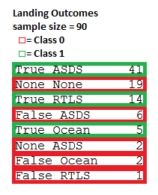
METHODOLOGY
Data Wrangling
Explored data to determine the label for training supervised models
Calculated the number of launches on each site
Calculated the number and occurrence of each orbit
Calculated the number and occurrence of mission outcome per orbit type
Created a landing outcome training label from 'Outcome' column
Training label: 'Class'
Class = 0; first stage booster did not land successfully
None None; not attempted
None ASDS; unable to be attempted due to launch failure
False ASDS; drone ship landing failed
False Ocean; ocean landing failed
False RTLS; ground pad landing failed
Class = 1; first stage booster landed successfully
True ASDS; drone ship landing succeeded
True RTLS; ground pad landing succeeded
True Ocean; ocean landing succeeded

Slide 10
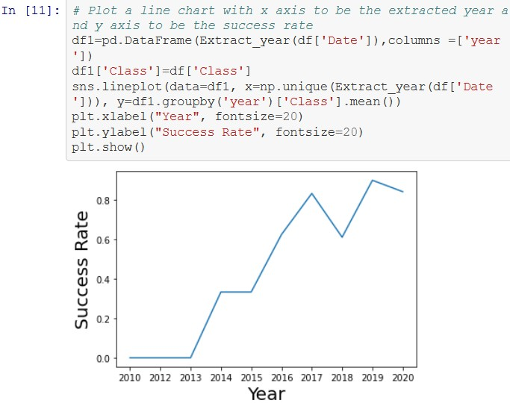
METHODOLOGY
Exploratory Data Analysis (EDA)
EDA with SQL
Loaded data into an IBM DB2 instance
Ran SQL queries to display and list information about
Launch sites
Payload masses
Booster versions
Mission outcomes
Booster landings
EDA with visualization
Read the dataset into a Pandas dataframe
Used Matplotlib and Seaborn visualization libraries to plot
FlightNumber x PayloadMass †
FlightNumber x LaunchSite †
Payload x LaunchSite †
Orbit type x Success rate
FlightNumber x Orbit type †
Payload x Orbit type †
Year x Success rate
screenshot of Year vs. Success rate* plot
*(of 1st stage booster landing)
† = with Class overlayed (1st stage booster landing outcome)

Slide 11
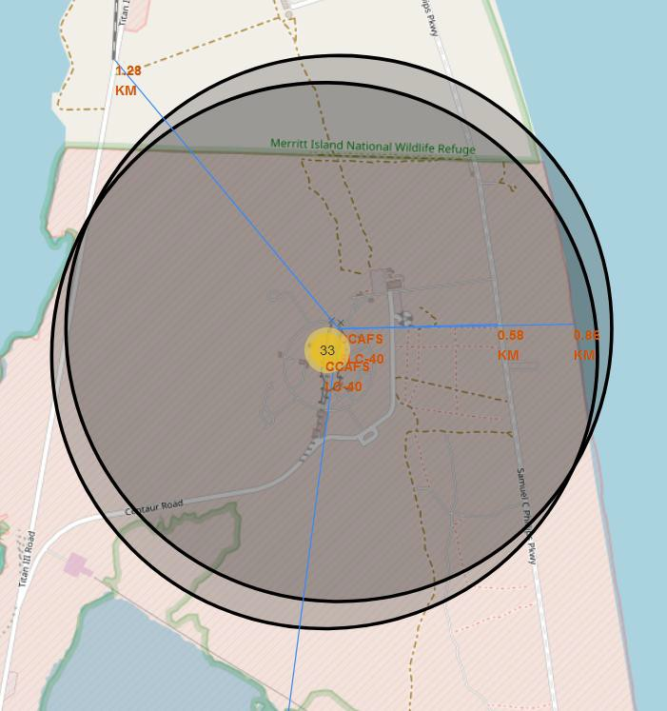
METHODOLOGY
Data Visualization
Launch Sites Location Analysis
Used Python interactive mapping library called Folium
Marked all launch sites on a map
Marked the successful/failed launches for each site on map
Calculated the distances between a launch site to its proximities
Railways
Highways
Coastlines
Cities
Launch Records Dashboard
Used Python interactive dashboarding library called Plotly Dash to
enable stakeholders to explore and manipulate data in an interactive and real-time
way
Pie chart showing success rate
Color coded by launch site
Scatter chart showing payload mass vs. landing outcome
Color coded by booster version
With range slider for limiting payload amount
Screenshot of interactive Folium map showing proximity from CCAFS SLC-40 launch site to nearby railway, highway, and coastline
Drop-down menu to choose between all sites and individual launch sites
Deployed to Heroku static web app hosting service

Slide 12
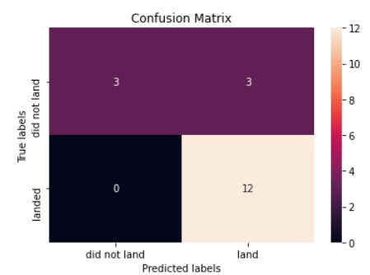
METHODOLOGY
Predictive Analysis (Model development)
Imported libraries and defined function to create confusion matrix
Pandas
Numpy
Matplotlib
Seaborn
Sklearn
Loaded the dataframe created during data collection
Created a column for our training label 'Class' created during data wrangling
Standardized the data
Split the data into training data and test data
Fit the training data to various model types
Logistic Regression
Support Vector Machine
Decision Tree Classifier
K Nearest Neighbors Classifier
Confusion matrix of logistic regression model, showing 15 correct predictions and 3 false positives
Used a cross-validated grid-search over a variety of hyperparameters to select
the best ones for each model
Enabled by Scikit-learn library function GridSearchCV
Evaluated accuracy of each model using test data to select the best model

Slide 13
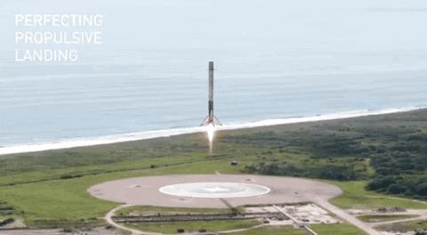
RESULTS
Exploratory data analysis results
Interactive analytics demo in screenshots
Predictive analysis results

Slide 14


Slide 15
RESULTS: EDA WITH SQL
The team at SpaceY had some very specific questions to answer with SQL:
What launch sites has SpaceX used?
CCAFS LC-40
CCAFS SLC-40
KSC LC-39A
VAFB SLC-4E
Examine launch site and date records where launch sites begin with the string 'CCA', do they overlap?
Last launch from CCAFS LC-40 was 2016-08-14
First launch from CCAFS SLC-40 was 2017-12-15
Wikipedia confirms Cape Canaveral Space Launch Complex 40 was renamed in 2017
Display the total payload mass carried by boosters launched by NASA (CRS)
45,596 KG, total
Display average payload mass carried by booster version F9 v1.1
340 KG, average
List the date when the first successful landing outcome in ground pad was achieved.
2015-12-22, more than 5 years after the first Falcon 9 launch on 2010-06-04

Slide 16
RESULTS: EDA WITH SQL (CONTINUED)
List the names of the boosters which have success in drone ship and have payload mass greater than 4000 but less than 6000
F9 FT B1021.1
F9 FT B1023.1
F9 FT B1029.2
F9 FT B1038.1
F9 B4 B1042.1
F9 B4 B1045.1
F9 B5 B1046.1
Rank the count of landing outcomes between the date 2010-06- 04 and 2017-03-20, in descending order
10 - No attempt5 - Failure (drone ship)
5 - Success (drone ship)
3 - Controlled (ocean)
3 - Success (ground pad)
2 - Failure (parachute)
2 - Uncontrolled (ocean)
1 - Precluded (drone ship)
List the names of the booster_versions which have carried the maximum payload mass.
F9 B5 B1048.4
F9 B5 B1048.5
F9 B5 B1049.4
F9 B5 B1049.5
F9 B5 B1049.7
F9 B5 B1051.3
F9 B5 B1051.4
F9 B5 B1051.6
F9 B5 B1056.4
F9 B5 B1058.3
F9 B5 B1060.2
F9 B5 B1060.3
List the failed landing_outcomes in drone ship, their booster versions, and launch site names for in year 2015
Failure (drone ship)
Failure (drone ship)
F9 v1.1 B1012 F9 v1.1 B1015
CCAFS LC-40 CCAFS LC-40
List the total number of successful and failure mission outcomes
1 - Failure (in flight)
99 - Success
1 - Success (payload status unclear)

Slide 17
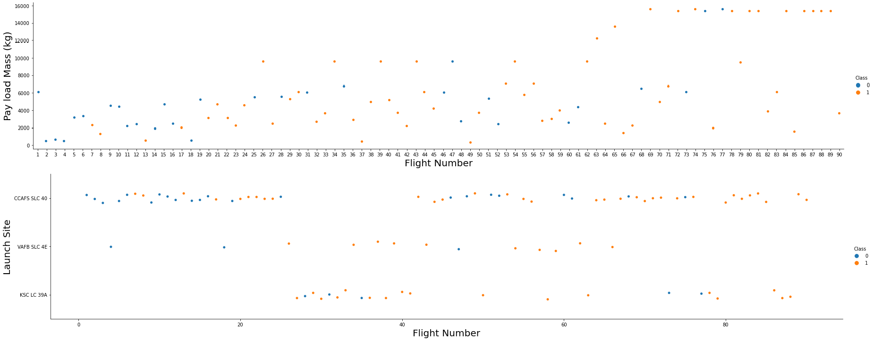
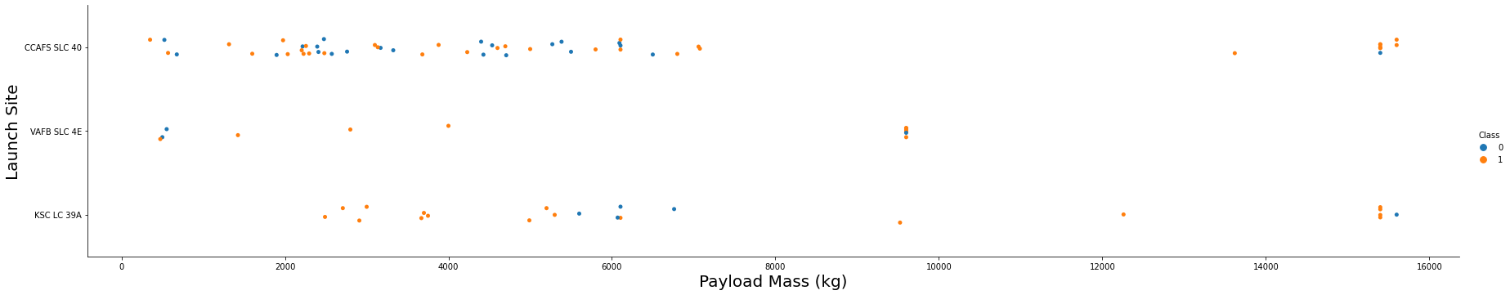
RESULTS: EDA WITH VISUALIZATION
FlightNumber x PayloadMass,
1st stage landing success positively correlated with continuous launch attempts, while negatively correlated with payload mass
FlightNumber x LaunchSite,
CCAFS SLC 40 appears to have been where most of the early 1st stage landing failures took place
PayloadMass x LaunchSite,
CCAFS SLC 40 and KSC LC 39A appear to
be favored for heavier payloads

Slide 18
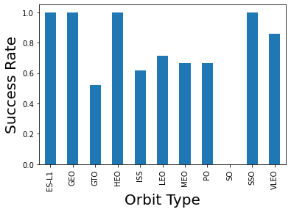
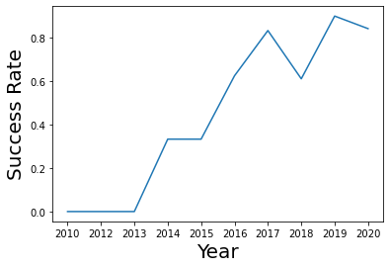
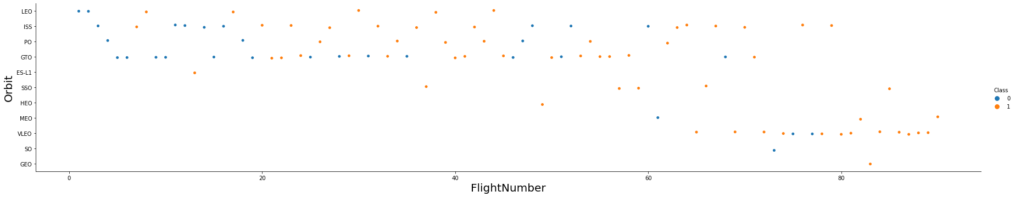
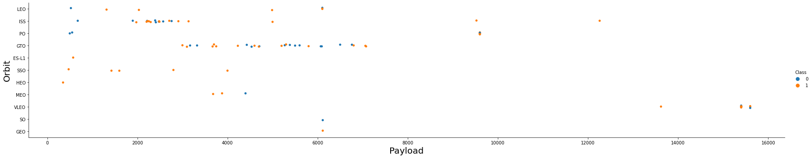
RESULTS: EDA WITH VISUALIZATION (CONTINUED)
Orbit type x Success rate,
All orbit types except 'SO' have had
successful 1st stage landings
Year x Success rate,
success rate trending positively on a yearly basis since 2013
FlightNumber x Orbit type,
flight number positively correlated with 1st stage recovery for all orbit types
PayloadMass x Orbit type,
heavier payloads have a negative influence on GTO orbits and positive influence on ISS orbits

Slide 19


Slide 20
RESULTS: LAUNCH SITE LOCATION ANALYSIS
Visualizing the launch sites on a map highlights the importance of launch site proximity to the coast and equator:

Slide 21
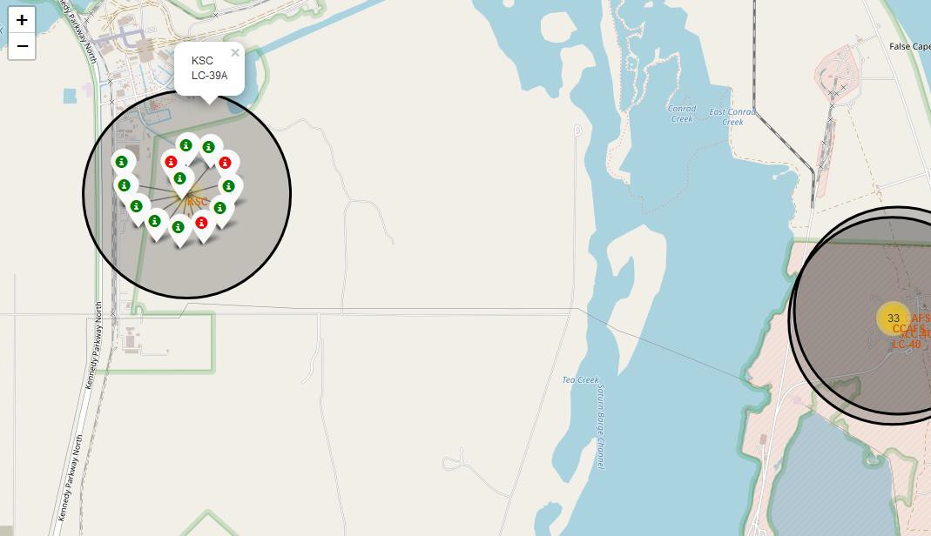
RESULTS: LAUNCH SITE LOCATION ANALYSIS (CONTINUED)
Visualizing the booster landing outcomes for each launch site highlights which launch sites have relatively high success rates, namely KSC LC39A

Slide 22
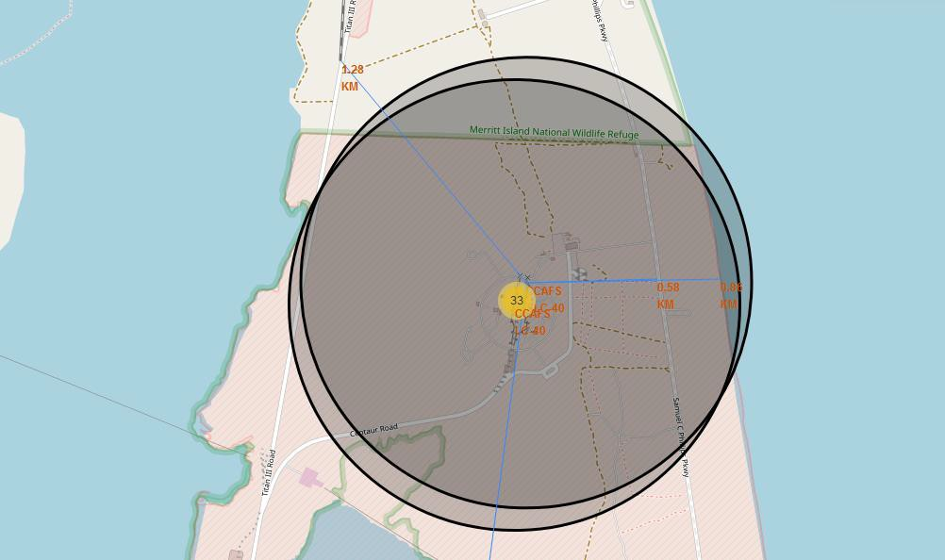
RESULTS: LAUNCH SITE LOCATION ANALYSIS (CONTINUED)
Visualizing the railway, highway, coastline, and city proximities for each launch site allows us to see how close each is, for example:
Proximities for CCAFS SLC-40:
railway: 1.28 km
transporting heavy cargo
highway: 0.58 km
transporting personel and equipment
coastline: 0.86 km
optionality to abort launch and attempt water landing
minimizing risk from falling debris
city: 51.43 km
minimizing danger to population dense areas.

Slide 23


Slide 24
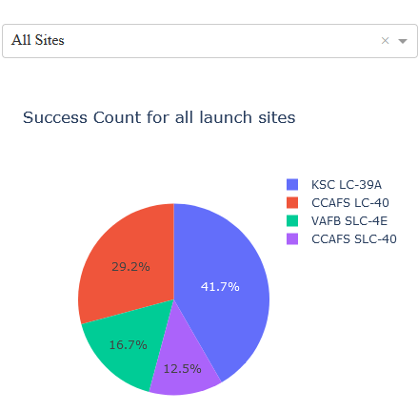
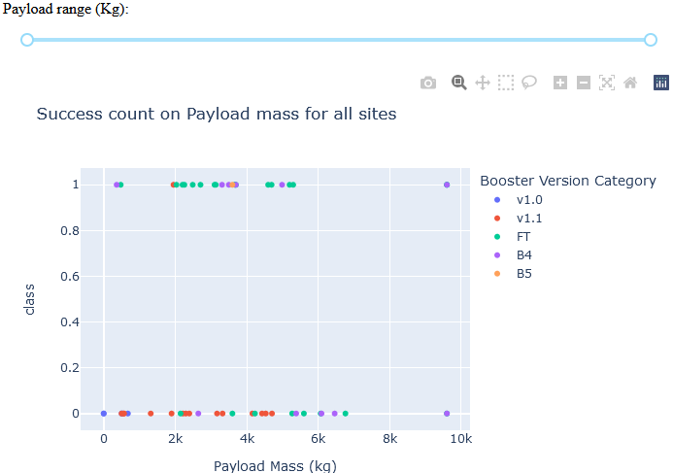
RESULTS: LAUNCH RECORDS DASHBOARD
Range slider for limiting payload amount
Drop-down menu to choose between all sites and individual launch sites
Scatter chart showing payload mass vs. landing outcome
Color coded by booster version
Color coded by launch site
Pie chart showing booster landing success rate

Slide 25
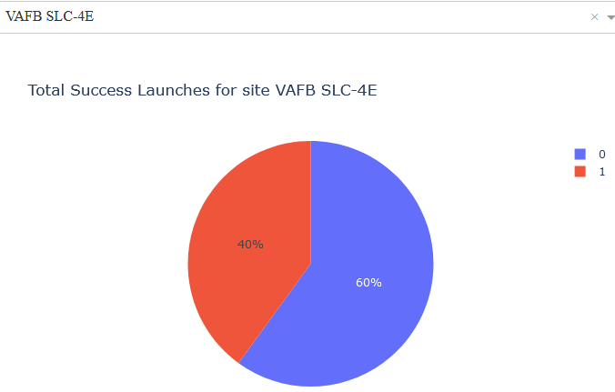
RESULTS: LAUNCH RECORDS DASHBOARD (CONTINUED)
Explore the dashboard yourself:
Enabling stakeholders to explore and manipulate the data in an interactive and real-time way
Dashboard observations:
FAFB SLC-4E had the heaviest successful booster landing success
KSC LC-39A has the highest booster landing success rate
Payloads < 5,300 kg had the highest booster landing success rate
Payloads > 5,300 kg had the lowest booster landing success rate
Example dashboard view:
Booster landing sucess rate for VAFB SLC-4E

Slide 26


Slide 27
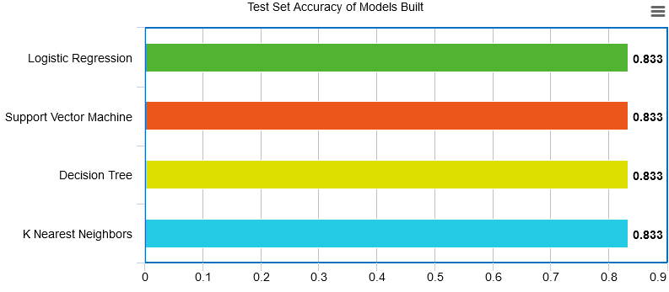
RESULTS: CLASSIFICATION ACCURACY
Each of the four models built came back with the same accuracy score, 83.33%

Slide 28
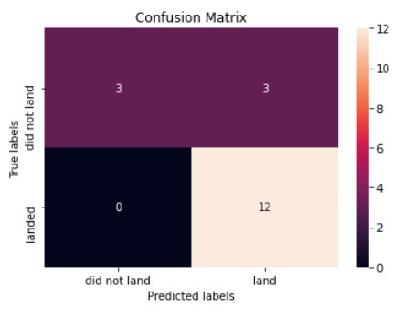
RESULTS: CONFUSION MATRIX
The confusion matrices of the best performing models (4-way-tie) are the same
The major problem is false positives as evidenced by the models incorrectly predicting the 1st stage booster to land in 3 out of 18 samples in the test set

Slide 29
CONCLUSION
Using the models from this report SpaceY can predict when SpaceX will successfully land the 1st
stage booster with 83.3% accuracy
SpaceX public statements indicate the 1st stage booster costs upwards of $15 million to build
This will enable SpaceY to make more informed bids against SpaceX, since they will have a good
idea when to expect the SpaceX bid to include the cost of a sacrificed 1st stage booster
With a list price of $62 million per launch, sacrificing the $15+ million 1st stage, would put the
SpaceX bid at upwards of $77 million
Biggest opportunities going forward to make even more informed bids:
Freeze the best performing combination of model and hyperparameters and re-fit using the whole dataset instead of just the training data
Potentially better than using only part of the data to fit the model, but you would no longer be able to measure the accuracy of
the resulting model
Incorporate additional launch data to the dataset and model as it becomes available
Subdivide the current model into two models
Predict if SpaceX will ATTEMPT to land the 1st stage
Predict if SpaceX will SUCCEED in their attempt
Create a related model that predicts if SpaceX will launch using a previously-flown 1st stage booster
Would enable SpaceY to take into account when the SpaceX bid would likely include a discount

Slide 30
APPENDIX
Notebooks to recreate dataset, analysis, and models:
https://github.com/ogulcanakca/Applied-Data-Science-Capstone/blob/486828a851d989d3705bc50855b69dd2f6e55a2a/SpaceX_Machine_Learning_Prediction_Part_5.jupyterlite.ipynb
https://github.com/ogulcanakca/Applied-Data-Science-Capstone/blob/486828a851d989d3705bc50855b69dd2f6e55a2a/jupyter-labs-eda-dataviz.ipynb
https://github.com/ogulcanakca/Applied-Data-Science-Capstone/blob/486828a851d989d3705bc50855b69dd2f6e55a2a/jupyter-labs-eda-sql-coursera_sqllite.ipynb
https://github.com/ogulcanakca/Applied-Data-Science-Capstone/blob/486828a851d989d3705bc50855b69dd2f6e55a2a/jupyter-labs-spacex-data-collection-api.ipynb
https://github.com/ogulcanakca/Applied-Data-Science-Capstone/blob/486828a851d989d3705bc50855b69dd2f6e55a2a/jupyter-labs-webscraping.ipynb
https://github.com/ogulcanakca/Applied-Data-Science-Capstone/blob/486828a851d989d3705bc50855b69dd2f6e55a2a/lab_jupyter_launch_site_location.ipynb
https://github.com/ogulcanakca/Applied-Data-Science-Capstone/blob/486828a851d989d3705bc50855b69dd2f6e55a2a/labs-jupyter-spacex-Data%20wrangling.ipynb
https://github.com/ogulcanakca/Applied-Data-Science-Capstone/blob/486828a851d989d3705bc50855b69dd2f6e55a2a/spacex_dash_app.py
Acknowledgments
Thank you to Joseph Santarcangelo at IBM for creating the course and materials
Instructors:
Rav Ahuja, Alex Aklson, Aije Egwaikhide, Svetlana Levitan, Romeo Kienzler, Polong Lin, Joseph Santarcangelo, Azim Hirjani, Hima Vasudevan, Saishruthi Swaminathan, Saeed Aghabozorgi, Yan Luo
References
https://datascience.stackexchange.com/a/33050
Explanation of why you would rebuild your model using the full dataset
https://www.spacex.com/vehicles/falcon-9/
Source of SpaceX's advertised $62 million launch price

Slide 31








